Slide 1
Teaching Aid Application for Students with Disabilities
By James Parry-Turner
Student Numbe:821554
Gregynog Presentation

Slide 2
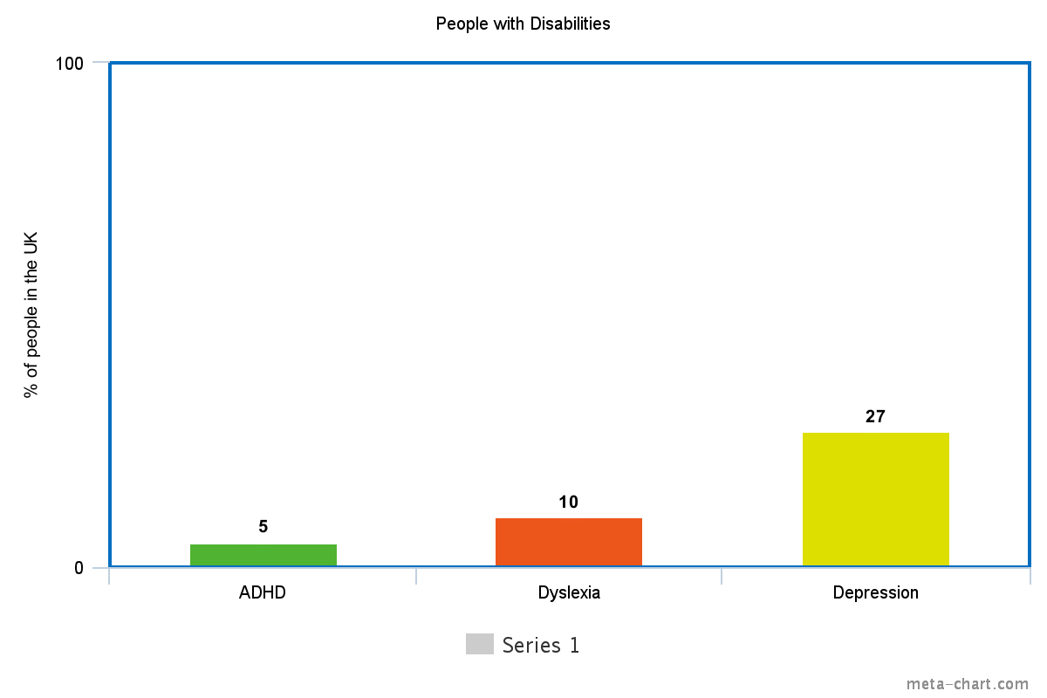
The Motivation behind this project:
Figure 1:
Bayram, N., & Bilgel, N. (2008). The prevalence and socio-demographic correlations of depression, anxiety and stress among a group of university students. Social Psychiatry and Psychiatric Epidemiology, 43(8), 667–672. https://doi.org/10.1007/s00127-008-0345-x
British Dyslexia Association. (2016). About the British Dyslexia Association | British Dyslexia Association. Retrieved from http://www.bdadyslexia.org.uk/about/20-Nov-2016
What is ADHD? | AADD-UK. (n.d.). Retrieved from https://aadduk.org/symptoms-diagnosis-treatment/20-Nov-2016

Slide 3
Tables of Content
Pedagogical needs of the students
Aims of the project
Why it’s a Web App
Data-Driven Document (D3) Tree for Students with Asperger’s

Slide 4
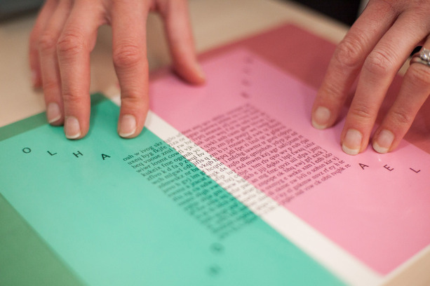
Pedagogical needs of the students
Pedagogical is a term used to define
the way the content is delivered to
the student. This is an extremely important
aspect in this project . The issue in the
project is to try and digitize the
approaches, for the students, into the application and try to humanize this approach for them.
Figure 1: Coloured Overlay Assessment and Meares-Irlen Syndrome. (n.d.). Retrieved from http://www.optometrists.co.uk/examinations/Coloured_Overlay_Assessment_and_Meares-Irlen_Syndrome/

Slide 5
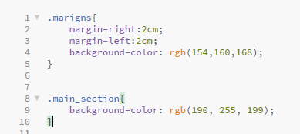
Aims of the project
There are two main aims that I
am trying to achieve. These are:
Ensure successful integration of needed pedagogical approaches.
Ensure content deliverable is to a decent standard.
These aims can be measured by
getting a set of students to use the
application at the end of each development phase.
Figure 1: Integration of a CSS colour pallet for Colour Blindness

Slide 6
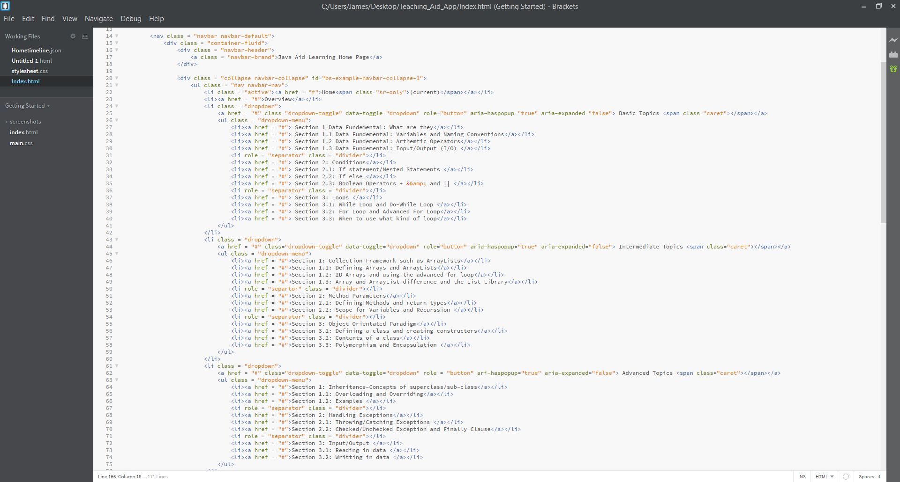
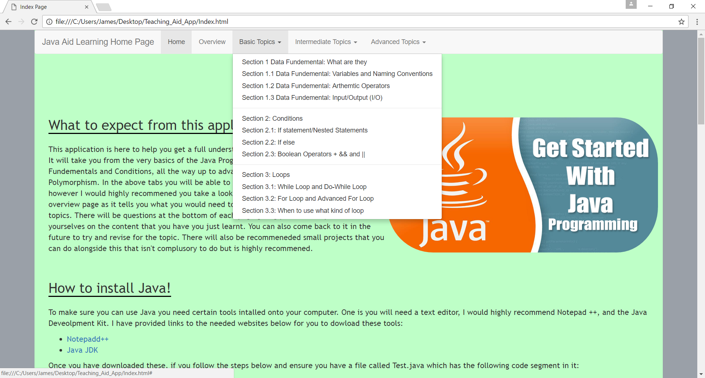
Why it’s a Web App
The reasons that the application has been
settled on after considering other options, such as a Java Applet, Mobile App, is
that the tools available to a
Web App is far greater and allows
for a more powerful application to try
and achieve the aims set.
Figure 1: HTML Code for the main page
Figure 2: Compiled and Running view for the main page

Slide 7
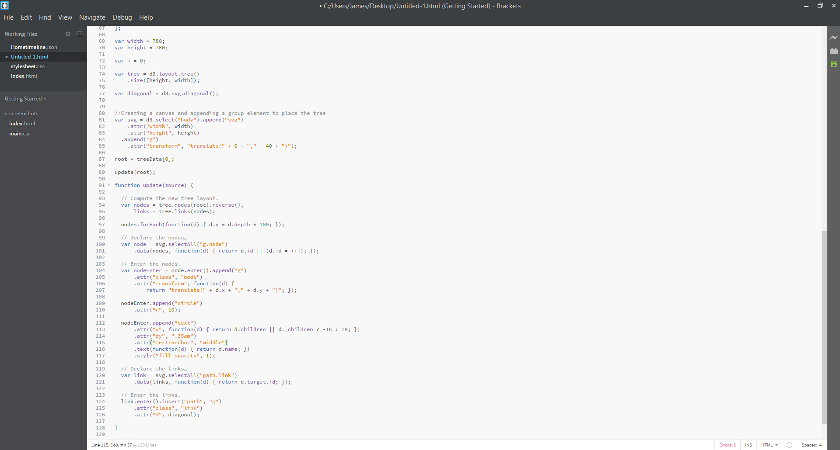
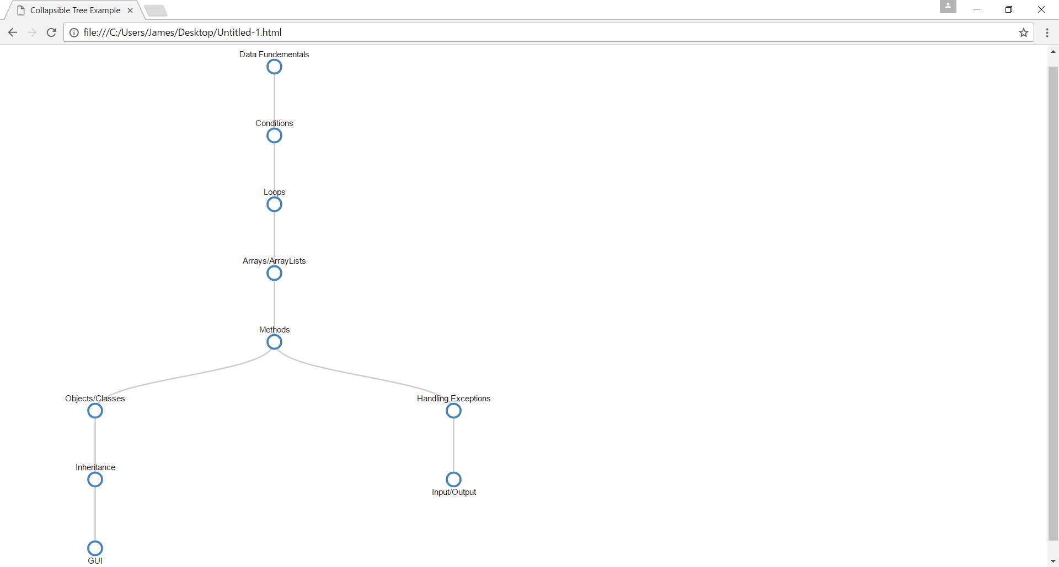
D3 Tree for Students with Asperger’s
In this example I am using the D3
treelayout to construct a knowledge model that
maps a pathway through the content of
the first years programming module. This benefits
students that suffers with Asperger's as they
thrive in situations where there is a
clear structure and wont result in them panicking.
Figure 1: Code snippet for the Treelayout from D3
Figure 2: Output for the Treelayout from D3

Slide 8
Summary
Almost there!
The main aspects that I’ve discussed today are:
Pedagogical aspects in planning the design for the application.
The end deliverable content that will be on the application.
Tools that support it’s development as a Web App.
An example on the implementation for Asperger’s.

Slide 9
Future Work
Main aspects to be done:
Continue research into pedagogical approaches focusing on Dyslexia and Anxiety
Improve the existing D3 Tree to allow an interactive nature.
Add jQuery integration to allow dynamic behaviour.
Implement the questions onto the app that have been designed.

